Slide 1
ONFORUMS:
A SHARED TASK ON ONLINE FORUM SUMMARIZATION
Josef Steinberger (UWB)
Mijail Kabadjov, Udo Kruschwitz & Massimo Poesio (UESSEX)

Slide 2
Outline
OnForumS @ MultiLing 2015
The task
Participants
Evaluation
Conclusions
SENSEI project

Slide 3
MULTILING 2015 @ SIGDIAL’15
Single-document Summarization
Multi-document Summarization
Online Forum Summarization PILOT
Argument summarization
Opinion Summarization
Call-Centre Conversation Summarization PILOT

Slide 4
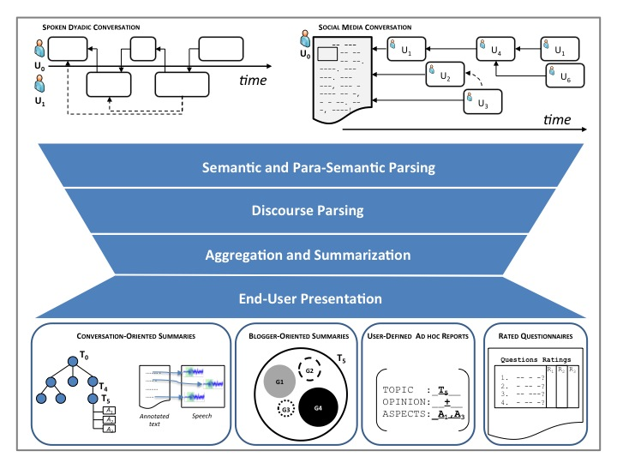
Prequel: the SENSEI project…

Slide 5
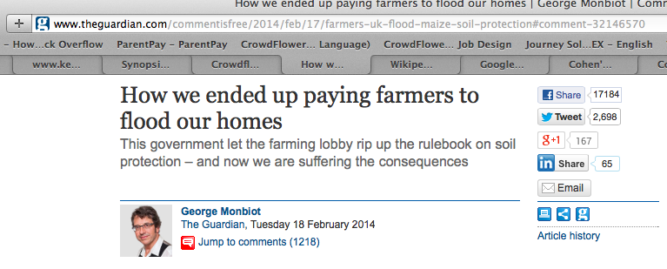
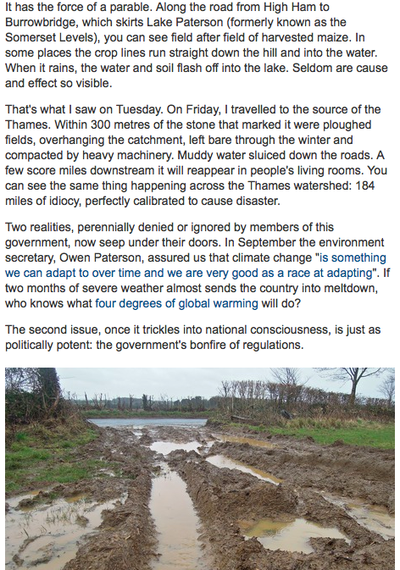
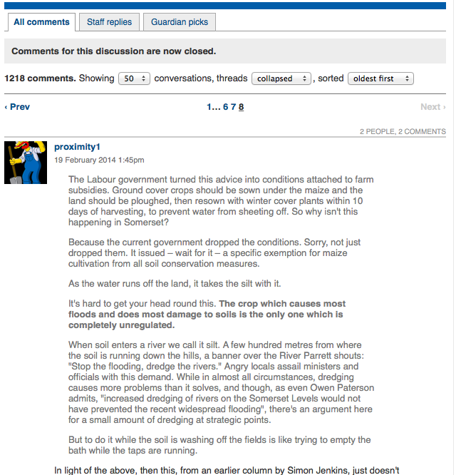
Online Forum Summarization (OnForumS): What to Summarize?
Number
of Likes
Number of
Comments
Article
Text
Comment
Replies
Long
Comment

Slide 6
Online Forum Summarization (OnForumS): Task Definition
In a pilot, three aspects of online forums summarization were highlighted:
Summary of the news article (e.g., key article sentences (KAS))
(Labelled) Links between comments and key article sentences
Summary of comments (e.g., key comment sentences (KCS))

Slide 7
Online Forum Summarization (OnForumS): Internal Pre-pilot A
Identified Link-Labelling as the OnForumS task
Two levels of labelling:
Argument <In_Favour, Impartial, Against, N/A>
Sentiment <Positive, Neutral, Negative, N/A>
Problem at the intersection of three NLP Areas
Argumentation Mining (Palau & Moens, 2011)
Sentiment Analysis (Pang & Lee, 2008)
Automatic Summarization (Giannakopoulos et al. in MultiLing’11/’13/’15)
Types of links:
Co-reference of enttities
Overlapping vocabulary
Reference to propositions
Common Events
Implicit (via inference), etc.
For example,
Article sentence: "How we ended up paying farmers to flood our homes"
Comment: "From a farming background I'm pro-farming but come on - to say farmers have no connection to flooding is like saying kids have no connection to ice cream."

Slide 8
Online Forum Summarization (OnForumS): DATA
Large data dumps have been created by Websays for English and Italian
For English: a corpus of ten news articles was extracted from data dumps and:
Circa 40K words
Pre-tokenised and Sentence split
Top 50 comments chosen based on number of likes
For Italian: a corpus of six blog articles was extracted:
Circa 40K words
Pre-tokenised and Sentence split
Top 50 comments

Slide 9
Online Forum Summarization (OnForumS): Evaluation via Crowdsourcing
After defining the task, we ran an internal and crowdsourcing pre-pilot B to come up with an evaluation framework for the task.
Drafted a questionnaire and circulated it internally
Based on this, designed a crowdsourcing HIT
Ran a first iteration of the HIT on CrowdFlower
Analysed and improved on the HIT
Ran a second iteration of the HIT on CrowdFlower
More fine-tuning of the HIT in further iterations

Slide 10
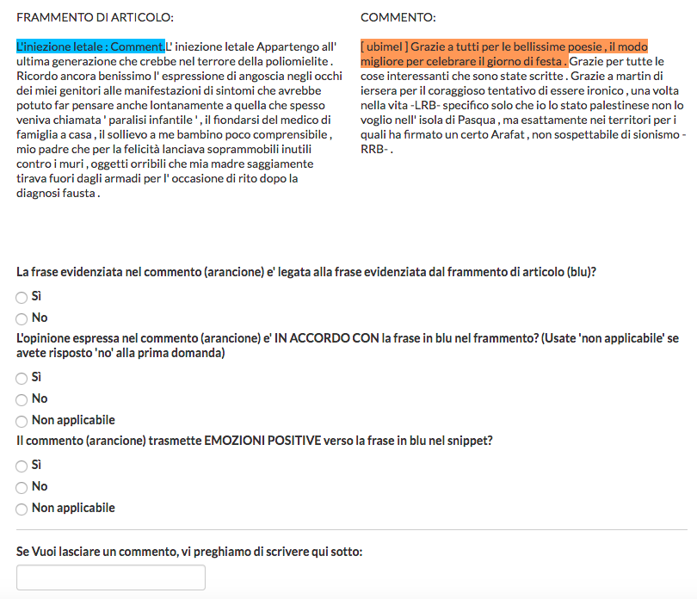
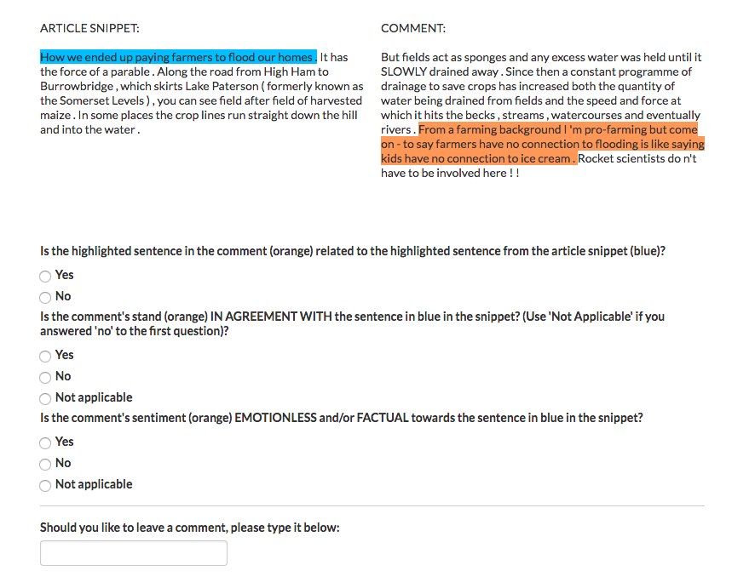
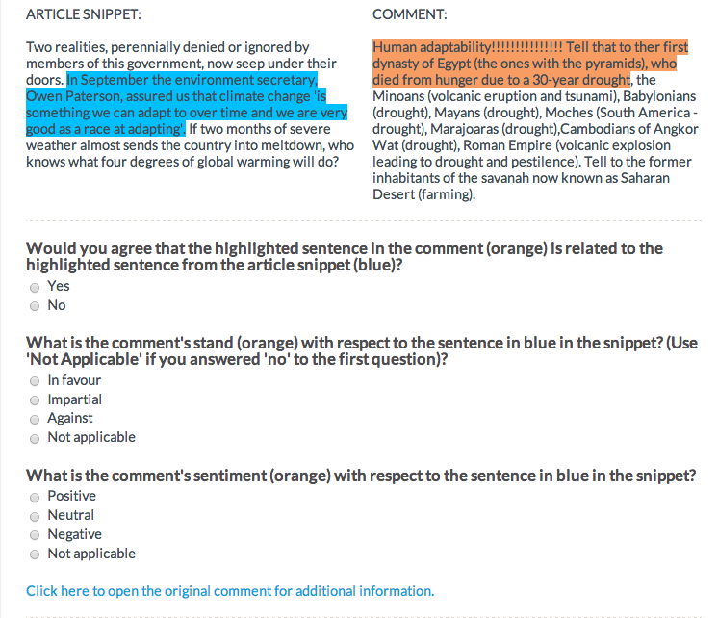
OnForums Crowdsourcing HIT: Annotation vs. Validation

Slide 11
Online Forum Summarization (OnForumS): Crowdsourcing
Mechanisms for Controlling the Quality of Answers
Test Questions + internal quality control framework of CrowdFlower for assessing contributor’s trustworthiness
Inter-annotator agreement (kappa scores of internal pre-pilot B with aggregated judgements)
In the future, to use a probabilisitc model of annotation (Passonneau & Carpenter, 2013)

Slide 12
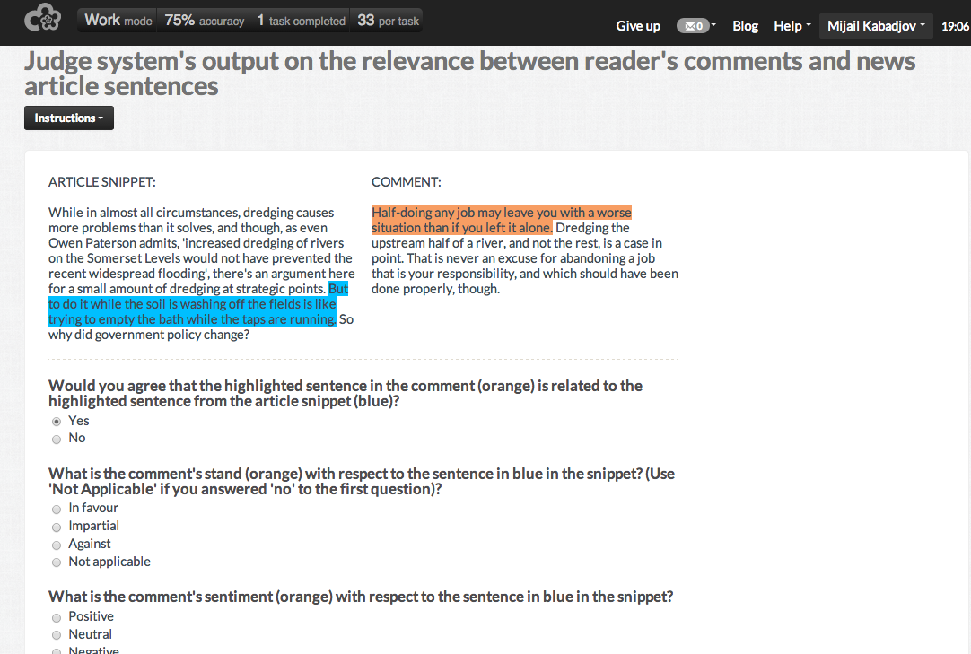
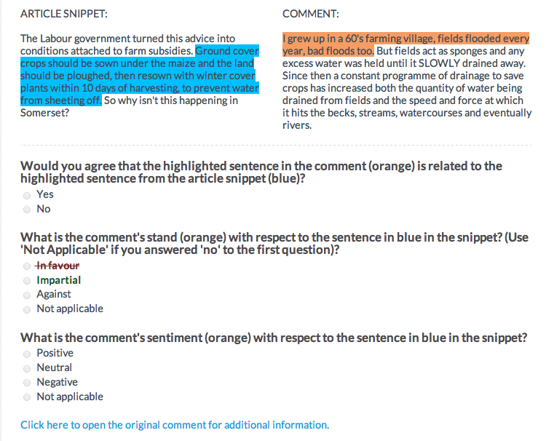
Online Forum Summarization (OnForumS): Crowdsourcing

Slide 13
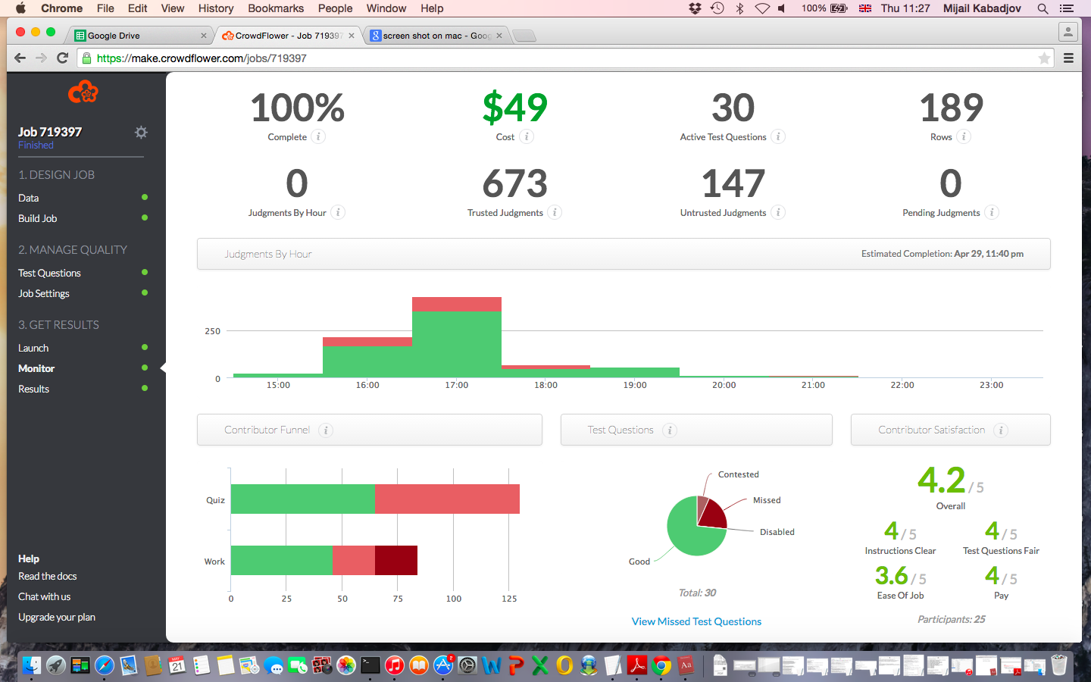
Briefly on CrowdFlower
It is a platform for crowdsourcing (i.e., annotating large amounts of data quickly and cheaply)
Configuration highlights:
3 judgements per row
5 rows per page
18 cents per page
Min. accuracy 70%
Min. time per page 60 sec
135 max. judgments per contributor (#test question x #rows pp.)
Provides various judgment aggregation schemes
We used “agg”: the contributor response with the highest confidence (agreement weighted by contributor trust) for each given field
Allows monitoring progress

Slide 14
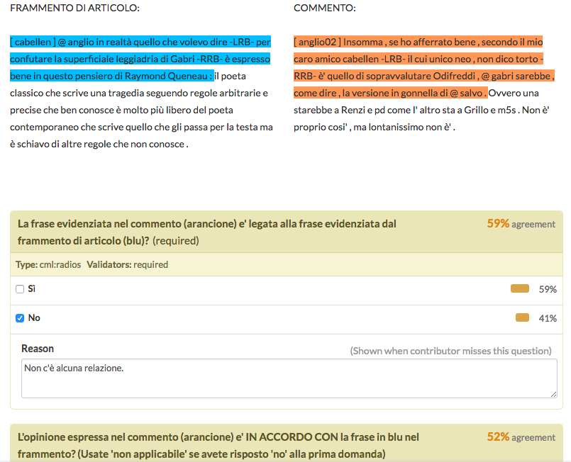
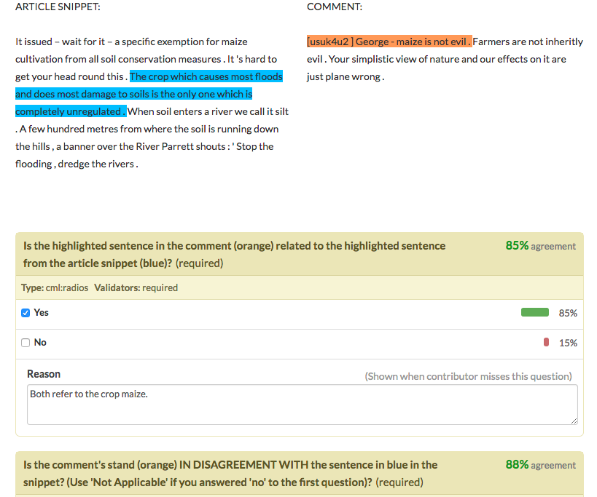
Briefly on CrowdFlower…
A CrowdFlower project consists of three main parts
Template for the crowdsourcing HIT (where input variables are defined)
Instructions for contributors (task description)
Data (rows to validate/annotate)
Create test questions (circa 10% of #rows)
Test questions:
are considered gold standard
are used in contributors training for the task
are used in monitoring/assessing contributors progress
Balancing positive vs. negative examples is crucial
creating counter-examples is effective and easy
Test questions can be created on CrowdFlower

Slide 15
Online Forum Summarization (OnForumS): Submissions
Four groups participated, submitting two runs each
USFD & UNITN
EC’s Joint Research Centre (JRC)
Beijing University of Posts and Telecommunication (CIST)
University of West Bohemia (UWB)
Two baselines:
First: links every comment sentence to first sentence of article or parent comment in case of comment replies
Overlap: links a comment sentence to the article (or parent comment) sentence with the most common words (stopwords are removed)
Both use the same approach, lexicon-based, for argument (Inquirer) and sentiment (MPQA lexicon)

Slide 16
Online Forum Summarization (OnForumS): Stratified Sample
Select a sample of system-proposed links for evaluation
Which links to select?
Assumption: links proposed by systems are more relevant (common in IR evaluation, e.g., pooling)
Grouping links into strata:
a) links proposed by 4 or more system runs (en: 21, it: 11)
b) links proposed by 3 system runs (en: 63, it: 20)
c) links proposed by 2 system runs (en: 2975, it: 2024)
d) links proposed by 1 system run (en: 3517, it: 2083)
Strategy: select all of a’s and b’s and randomly one third of c’s and one third of d’s

Slide 17
Online Forum Summarization (OnForumS): Evaluation (en)
Just like with IR systems, only Precision can be computed directly from the crowdsourcing evaluation (by counting yes’s and no’s for each dimension, linking, argument and sentiment)
System run | Prec (Link) | System run | Prec (Argument) | System run | Prec (Sentiment)
BASE-overlap | 0.931034483 | CIST-run2 | 0.992920354 | CIST-run1 | 0.950819672
USFD_UNITN-run2 | 0.887096774 | CIST-run1 | 0.990974729 | CIST-run2 | 0.939285714
UWB-run1 | 0.864583333 | UWB-run1 | 0.975 | BASE-overlap | 0.9375
UWB-run2 | 0.864583333 | UWB-run2 | 0.975 | BASE-first | 0.934895833
JRC-run1 | 0.862068966 | BASE-first | 0.926701571 | USFD_UNITN-run2 | 0.925925926
JRC-run2 | 0.831325301 | JRC-run2 | 0.907063197 | JRC-run2 | 0.902985075
USFD_UNITN-run1 | 0.818731118 | USFD_UNITN-run1 | 0.893939394 | USFD_UNITN-run1 | 0.898113208
BASE-first | 0.742537313 | JRC-run1 | 0.888888889 | UWB-run1 | 0.888888889
CIST-run2 | 0.717852684 | BASE-overlap | 0.886075949 | UWB-run2 | 0.888888889
CIST-run1 | 0.708542714 | USFD_UNITN-run2 | 0.862385321 | JRC-run1 | 0.878612717

Slide 18
Online Forum Summarization (OnForumS): Evaluation (it)
And for Italian…
GroupAndRun | Prec (Link) | GroupAndRun | Prec (Argument) | GroupAndRun | Prec (Sentiment)
BASE-overlap | 0.590909091 | CIST-run2 | 1 | CIST-run1 | 0.666666667
UWB-run1 | 0.25 | UWB-run1 | 1 | BASE-overlap | 0.5
USFD_UNITN-run1 | 0.2 | CIST-run1 | 0.777777778 | JRC-run1 | 0.375
JRC-run1 | 0.152380952 | BASE-first | 0.75 | BASE-first | 0.333333333
CIST-run1 | 0.084269663 | BASE-overlap | 0.692307692 | UWB-run1 | 0.25
CIST-run2 | 0.033333333 | JRC-run1 | 0.44 | CIST-run2 | 0
BASE-first | 0.010309278 | USFD_UNITN-run1 | 0 | USFD_UNITN-run1 | 0

Slide 19
Online Forum Summarization (OnForumS): P/R/F1 Argument
Having a gold standard enables computing P/R/F1 measures per label
IN_FAVOUR |  | AGAINST |  | IMPARTIAL
GroupAndRun | Recall | GroupAndRun | Recall | GroupAndRun | Recall
CIST-run1 | 83.08823529 | UWB-run2 | 2.941176471 | BASE-overlap | 9.191176471
CIST-run2 | 55.14705882 | BASE-first | 0 | JRC-run1 | 7.536764706
UWB-run1 | 21.32352941 | BASE-overlap | 0 | JRC-run2 | 7.536764706
UWB-run2 | 19.85294118 | CIST-run1 | 0 | BASE-first | 0
BASE-overlap | 10.29411765 | CIST-run2 | 0 | CIST-run1 | 0
JRC-run1 | 1.470588235 | JRC-run1 | 0 | CIST-run2 | 0
JRC-run2 | 1.470588235 | JRC-run2 | 0 | USFD_UNITN-run1 | 0
BASE-first | 0 | USFD_UNITN-run1 | 0 | USFD_UNITN-run2 | 0
USFD_UNITN-run1 | 0 | USFD_UNITN-run2 | 0 | UWB-run1 | 0
USFD_UNITN-run2 | 0 | UWB-run1 | 0 | UWB-run2 | 0

Slide 20
Online Forum Summarization (OnForumS): P/R/F1 Sentiment
POSITIVE |  | NEGATIVE |  | NEUTRAL
GroupAndRun | Recall | GroupAndRun | Recall | GroupAndRun | Recall
CIST-run1 | 100 | UWB-run2 | 6.666666667 | JRC-run1 | 14.44444444
CIST-run2 | 63.33333333 | BASE-first | 0 | JRC-run2 | 14.44444444
BASE-overlap | 13.33333333 | BASE-overlap | 0 | BASE-overlap | 3.333333333
UWB-run1 | 10 | CIST-run1 | 0 | UWB-run1 | 3.333333333
UWB-run2 | 6.666666667 | CIST-run2 | 0 | UWB-run2 | 3.333333333
BASE-first | 0 | JRC-run1 | 0 | BASE-first | 0
JRC-run1 | 0 | JRC-run2 | 0 | CIST-run1 | 0
JRC-run2 | 0 | USFD_UNITN-run1 | 0 | CIST-run2 | 0
USFD_UNITN-run1 | 0 | USFD_UNITN-run2 | 0 | USFD_UNITN-run1 | 0
USFD_UNITN-run2 | 0 | UWB-run1 | 0 | USFD_UNITN-run2 | 0

Slide 21
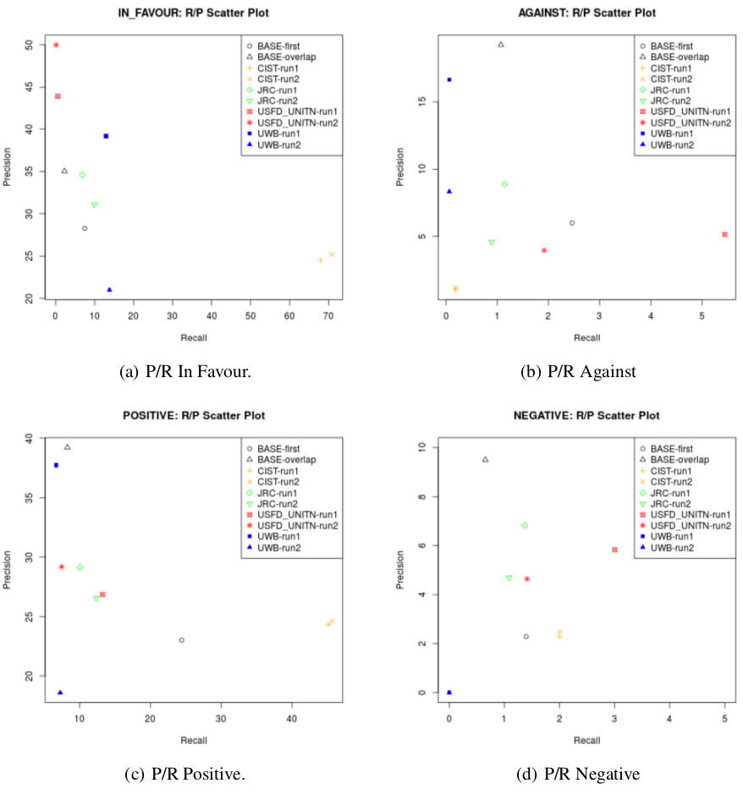
P/R Scatter Plots

Slide 22
Conclusions OnForumS
Part of MultiLing 2015 at SIGdial 2015
Link and label comments to key article sentences (argument&sentiment)
Evaluate participating systems in two stages:
Draw random samples (in a stratified fashion)
Evaluate the samples via crowdsourcing
The feasibility of both task and evaluation were pre-piloted
Newswire domain
Eight system runs submitted by four research groups
Two baselines: no system run surpassed the baseline for linking
Next steps
Use a different aggregation scheme (probabilistically motivated)
Preserve whole conversation threads
Exploitation of laballed links for summarisation, infromation digest, etc.
Next OnForumS in 2017?

Slide 23
Conclusions OnForumS
First attempt at:
encompassing automatic summarisation, argumentation mining and sentiment analysis into one shared task
bringing crowdsourcing to the evaluation of systems for automatic summarisation and argument structure parsing
Key challenges ahead:
Aggregate better crowdsourcing data
Bring in to the task definition higher-level units (e.g., whole threads)

Slide 24
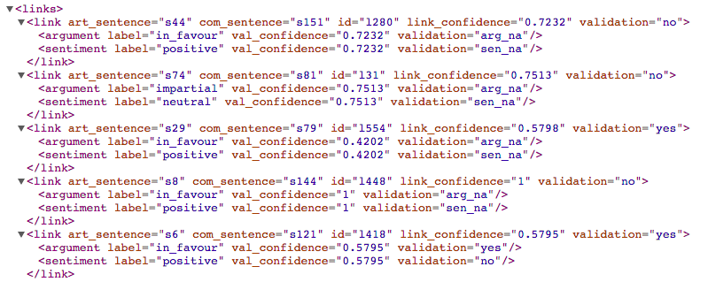
Online Forum Summarization (OnForumS): Creating Gold Data
From the validated links by crowdsourcing, there are two ways for creating golden data (non-exhaustive):
A) By validation: Any link and labels that have a validation=“yes” (aggregated) effectively are gold labels
B) By exclusion: if the same link (i.e., pair of sentences) have had three out of four labels validated with “no”, then the remaining fourth label is taken as gold label
Using XML input files and the aggregated labels from CrowdFlower, gold XML files were created and released at: http://multiling.iit.demokritos.gr/pages/view/1531/task-onforums-data-and-information

