Slide 1
Multilingual Summarization with Polytope Model
Marina Litvak and Natalia Vanetik
Shamoon College of Engineering
Israel
September 2015

Slide 2
MultiLing 2015 Tasks
Multilingual Multi-document Summarization (MMS)
Multilingual Single-document Summarization (MSS)
Online Forum Summarization (OnForumS)
Call Centre Conversation Summarization (CCCS)
38 languages
Texts up to 100Kb

Slide 3
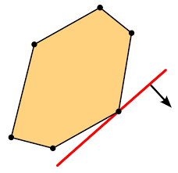
Our system
Extractive summarization
Unsupervised
Based on the polytope model
Uses LP over rationals
Uses three different objective functions

Slide 4
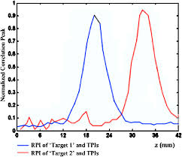
Initial preprocessing
English, Hebrew and Arabic languages
Preprocessing steps
Sentence splitting
Tokenization
Stemming
English: PorterStemmer
Hebrew, Arabic: cross-correlation
Stop word removal
Terms = stemmed tokens

Slide 5
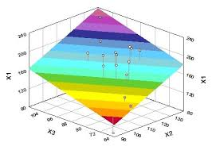
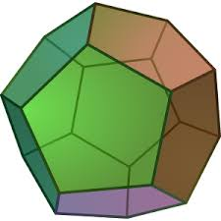
Polytope model
Term appearances = variables
Sentence = linear inequality = hyperplane
Text = hyperplane intersection = polytope
Polytope facets = possible summaries

Slide 6
Step 1: variables
Express term appearances as variables
variables are 0-1 bounded
0 means the word is not chosen
1 means the word is chosen
Text
If man could be crossed with the cat it would improve man,
but it would deteriorate the cat.
Term appearance variables after preprocessing
man cross cat improv man deterior cat

Slide 7
Step 2: sentences
Sentence → linear inequality → hyperplane
hyperplanes intersect in multidimensional space
intersecting hyperplanes define a polyhedron
Sentence as a linear inequality:
man cross cat improv man deterior cat
Linear inequality = lower half-space
in a multidimensional Eucledian space
Number of term appearances

Slide 8
Step 3
Text → hyperplane intersection → polytope
in our case, hyperplane intersection is bounded
bounded polyhedron is called a polytope
Additional constraints → more hyperplanes
summary length
maximal number of different terms
…

Slide 9
Step 4
Polytope facets represent all possible summaries
choose an objective function
solve as LP problem over rationals
compute variable and sentence scores
choose high-scored sentences

Slide 10
Objective functions
How to choose an objective function?
maximize information coverage
more than one option exists
we do not know which function is
optimized by human brain…
Advantages
polynomial in theory
very fast in practice
f(x)
Point of optimum on
the polytope
?

Slide 11
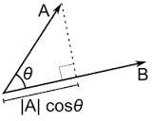
Function #1: Maximal Relevance
Goal: maximize relevance of chosen sentences while minimizing their pairwise redundancy
Relevance measure: cosine similarity to the text
Redundancy measure: cosine similarity between pair of sentences
Example:

Slide 12
Function #2: Sum of Bigrams
Goal: maximize bigram coverage
Bigram = pair of consecutive terms
Weight of bigram = # of its appearances in the text
Example:

Slide 13
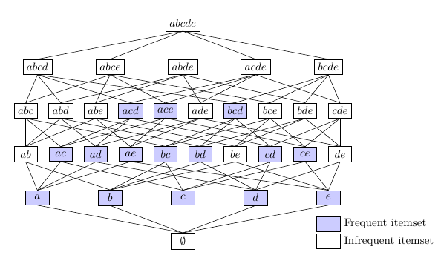
Function #3: Frequent Itemsets
Goal: maximize relevance of chosen sentences while minimizing their pairwise redundancy
Relevance measure: coverage of frequent itemsets
Redundancy measure: cosine similarity between pair of sentences

Slide 14
Function #3 (2)
Sentences = transactions, terms = items
Text = transactional database
0 < Support < 1
Itemset = {set of terms}
Frequent itemset = Support(Itemset)>=Support

Slide 15
Function #3 (3)
Finding frequent itemsets – many algorithms (Apriori, Apriori-TID, FPGrowth, …)
Frequent itemsets = generalization of n-grams, n=1,2,3,…
Example:

Slide 16
ROUGE-1 - English
MSS: 4th rank out of 9 participants
MMS: 4th rank out of 9 participants
Function #3

Slide 17
ROUGE-1 - Hebrew
MSS: only 3rd rank out of 7 participants
MMS: 3rd place out of 9 participants
Function #1

Slide 18
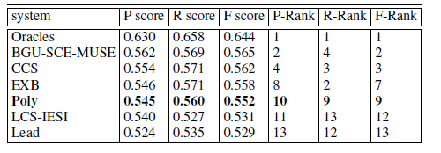
ROUGE-1 - Arabic
MSS: only 5th rank out of 7 participants
MMS: 4th place out of 9 participants;
the highest recall
Function #1

Slide 19
Thank you!
Questions???

